Slide 1


Machine Learning 4. Logistic Regression
Xueyuan Gong
School of Intelligent Systems Science and Engineering

Slide 2
Classification
Binary classification: predicting a binary-valued target
Multiclass classification: predicting a discrete(> 2)-valued target
Examples of binary classification
Predict whether a patient has a disease, given the presence or absence of various symptoms
Classify e-mails as spam or non-spam
Predict whether a financial transaction is fraudulent

Slide 3
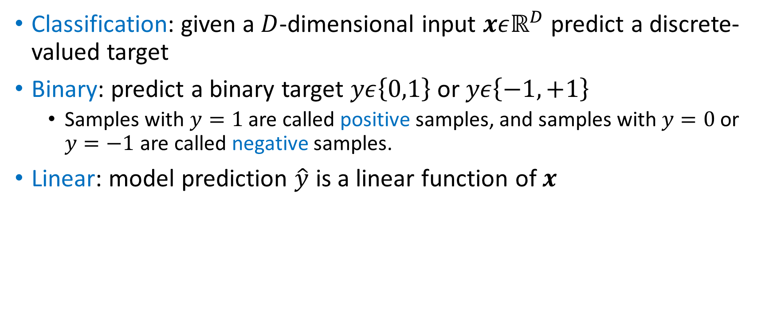
Binary Linear Classification
Classification: given a $D$-dimensional input $xεℝ^{D}$ predict a discrete-valued target
Binary: predict a binary target $yε\left\{0,1\right\}$ or $yε\left\{−1,+1\right\}$
Samples with $y=1$ are called positive samples, and samples with $y=0$ or $y=−1$ are called negative samples.
Linear: model prediction $\hat{y}$ is a linear function of $x$

Slide 4
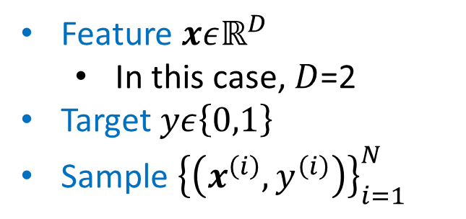
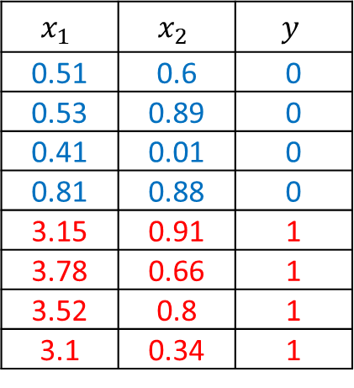
Binary Classification Problem
Dataset
Feature $xεℝ^{D}$
In this case, $D$=2
Target $yε\left\{0,1\right\}$
Sample ${\left\{\left(x^{\left(i\right)},y^{\left(i\right)}\right)\right\}}_{i=1}^{N}$
$$x_{1}$$ | $$x_{2}$$ | $$y$$
0.51 | 0.6 | 0
0.53 | 0.89 | 0
0.41 | 0.01 | 0
0.81 | 0.88 | 0
3.15 | 0.91 | 1
3.78 | 0.66 | 1
3.52 | 0.8 | 1
3.1 | 0.34 | 1
What is the biggest difference between regression and classification?

Slide 5
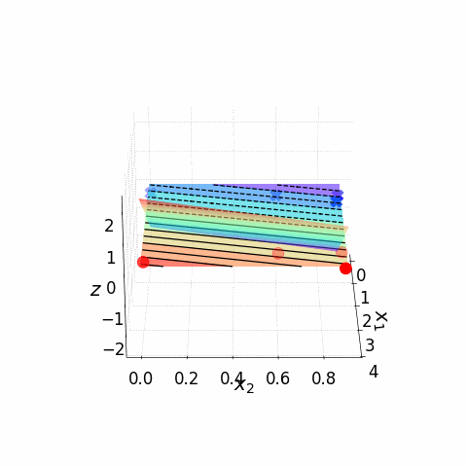
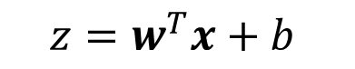
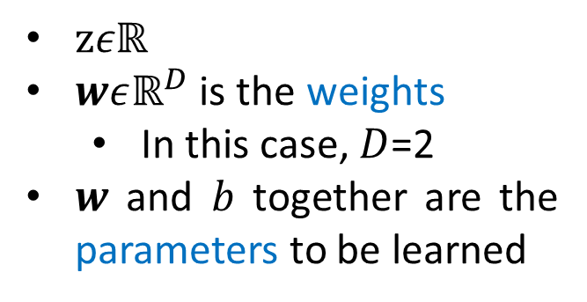
Binary Classification Problem
Model
$$z=w^{T}x+b$$
$zεℝ$
$wεℝ^{D}$ is the weights
In this case, $D$=2
$w$ and $b$ together are the parameters to be learned

Slide 6
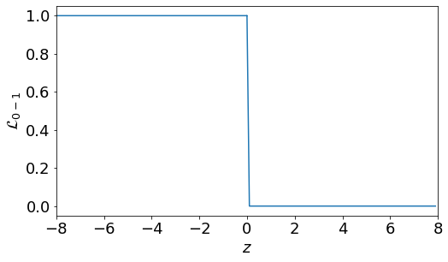
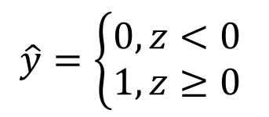
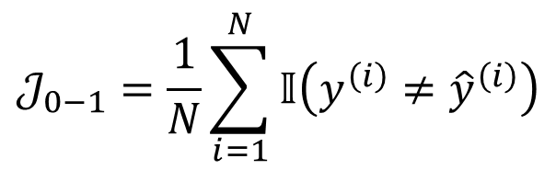
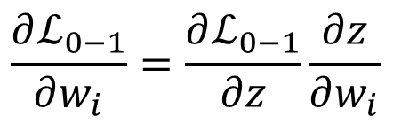
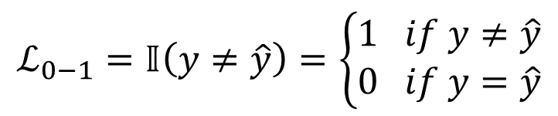
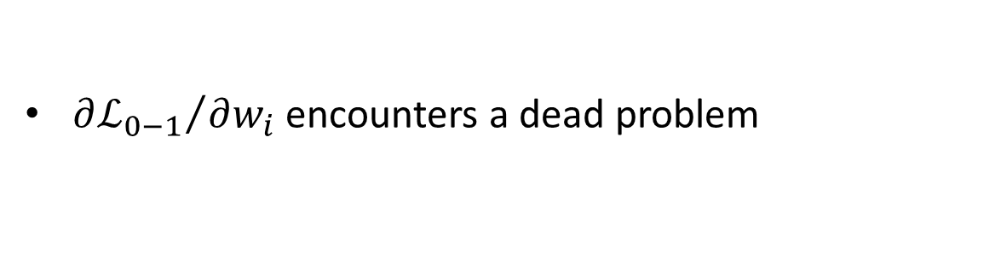
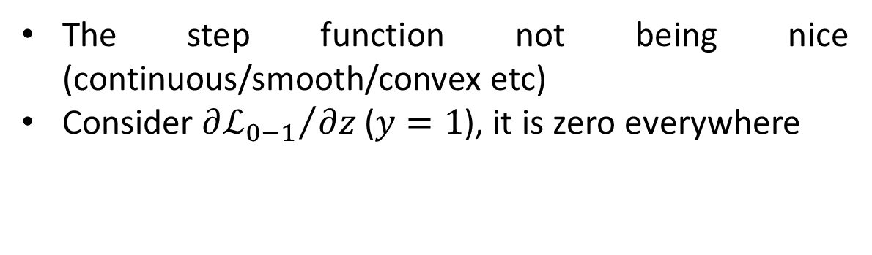
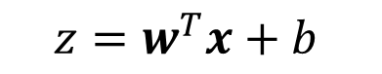
*0-1 Loss
Model
The step function not being nice (continuous/smooth/convex etc)
Consider ${∂ℒ_{0−1}}/{∂z}$ ($y=1$), it is zero everywhere
$$z=w^{T}x+b$$
$$\hat{y}=\left\{\begin{aligned}0,z<0 \\ 1,z≥0\end{aligned}\right.$$
Loss Function
$$ℒ_{0−1}=𝕀\left(y≠\hat{y}\right)=\left\{\begin{aligned}1 if y≠\hat{y} \\ 0 if y=\hat{y}\end{aligned}\right.$$
Cost Function
Chain Rule!!!
${∂ℒ_{0−1}}/{∂w_{i}}$ encounters a dead problem
$$𝒥_{0−1}=\frac{1}{N}\sum_{i=1}^{N}{𝕀\left({y^{\left(i\right)}≠\hat{y}}^{\left(i\right)}\right)}$$
$$\frac{∂ℒ_{0−1}}{∂w_{i}}=\frac{∂ℒ_{0−1}}{∂z}\frac{∂z}{∂w_{i}}$$

Slide 7
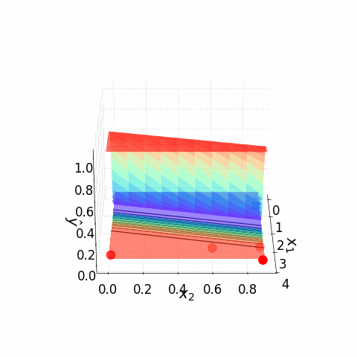
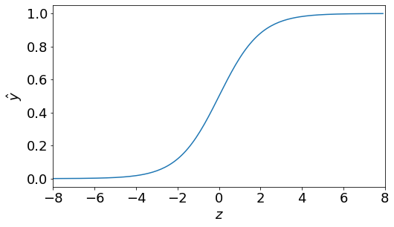
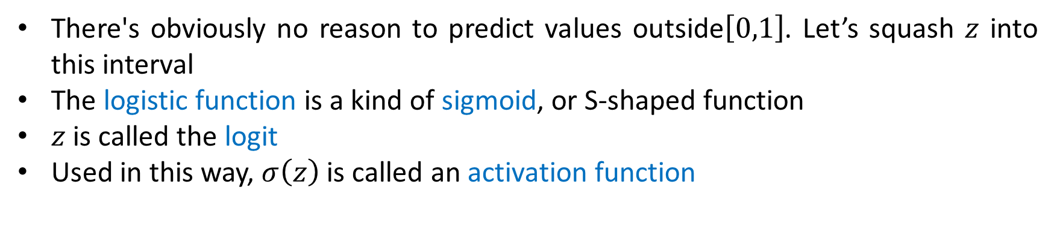
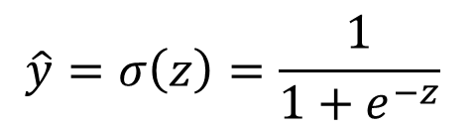
Sigmoid Function
Model
$$z=w^{T}x+b$$
$$\hat{y}=σ\left(z\right)=\frac{1}{1+e^{−z}}$$
There's obviously no reason to predict values outside$\left[0,1\right]$. Let’s squash $z$ into this interval
The logistic function is a kind of sigmoid, or S-shaped function
$z$ is called the logit
Used in this way, $σ\left(z\right)$ is called an activation function

Slide 8
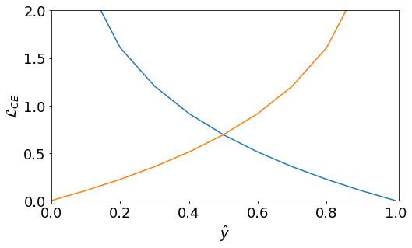
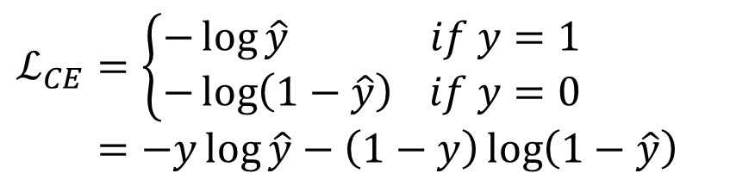
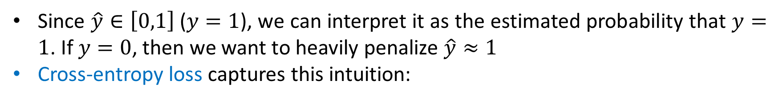
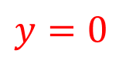
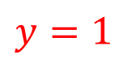
Binary Cross-entropy loss
Since $\hat{y}∈\left[0,1\right]$ ($y=1$), we can interpret it as the estimated probability that $y=1$. If $y=0$, then we want to heavily penalize $\hat{y}≈1$
Cross-entropy loss captures this intuition:
$$ℒ_{CE}=\left\{\begin{aligned}−\log{\hat{y}} if y=1 \\ −\log\left(1−\hat{y}\right) if y=0\end{aligned}\right.=−y\log{\hat{y}}−\left(1−y\right)\log\left(1−\hat{y}\right)$$
$$y=0$$
$$y=1$$

Slide 9
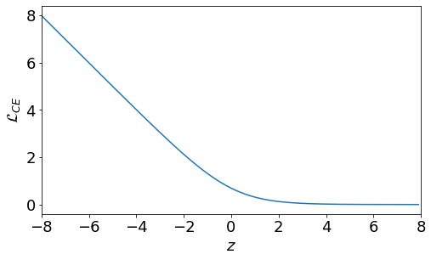
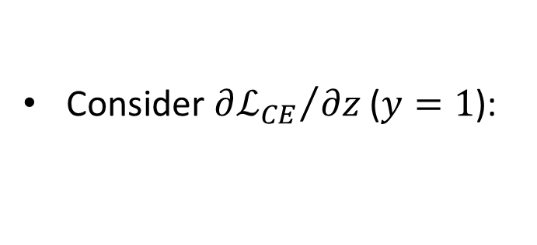
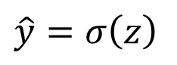
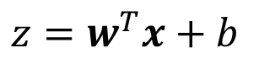
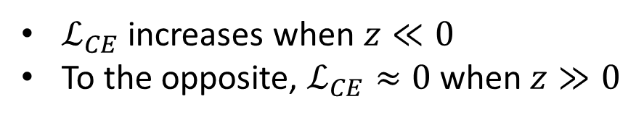
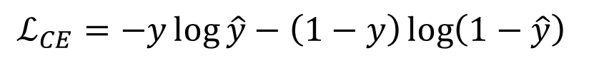
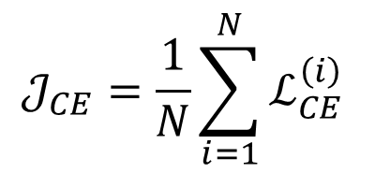
Logistic Regression
Model
Consider ${∂ℒ_{CE}}/{∂z}$ ($y=1$):
$$z=w^{T}x+b$$
$$\hat{y}=σ\left(z\right)$$
Loss Function
$$ℒ_{CE}=−y\log{\hat{y}}−\left(1−y\right)\log\left(1−\hat{y}\right)$$
Cost Function
$ℒ_{CE}$ increases when $z≪0$
To the opposite, $ℒ_{CE}≈0$ when $z≫0$
$$𝒥_{CE}=\frac{1}{N}\sum_{i=1}^{N}{ℒ_{CE}^{\left(i\right)}}$$

Slide 10
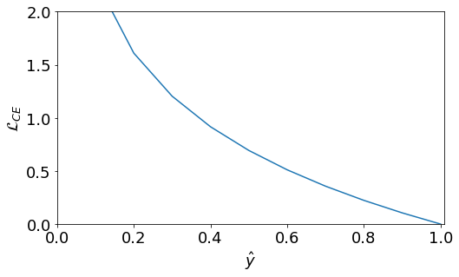
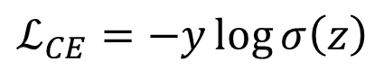
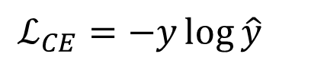
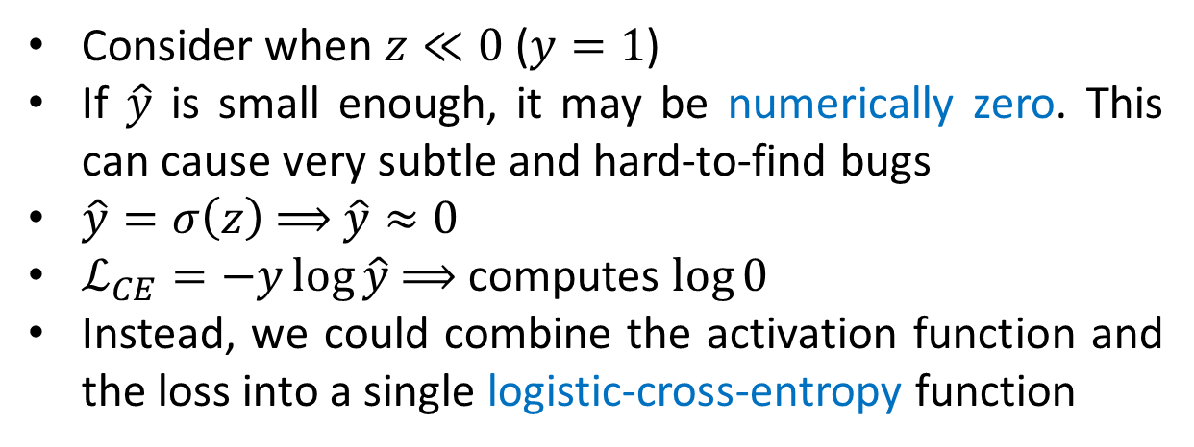
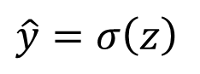
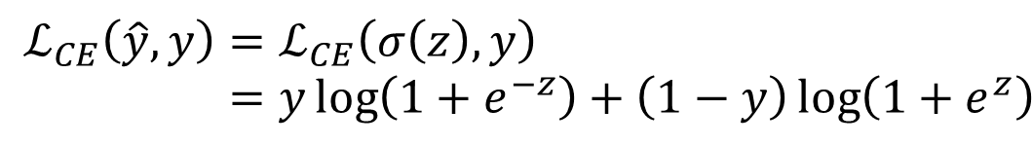
*Numerical Stability
$$\hat{y}=σ\left(z\right)$$
Consider when $z≪0$ ($y=1$)
If $\hat{y}$ is small enough, it may be numerically zero. This can cause very subtle and hard-to-find bugs
$\hat{y}=σ\left(z\right)$ $⟹$ $\hat{y}≈0$
$ℒ_{CE}=−y\log{\hat{y}}$ $⟹$ computes $\log{0}$
Instead, we could combine the activation function and the loss into a single logistic-cross-entropy function
$$ℒ_{CE}=−y\log{\hat{y}}$$
$$ℒ_{CE}\left(\hat{y},y\right)=ℒ_{CE}\left(σ\left(z\right),y\right)=y\log\left(1+e^{−z}\right)+\left(1−y\right)\log\left(1+e^{z}\right)$$
$$ℒ_{CE}=−y\log{σ\left(z\right)}$$

Slide 11
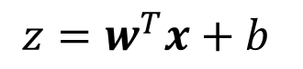
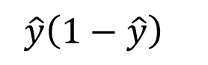
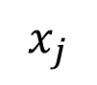
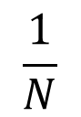
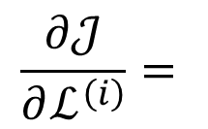
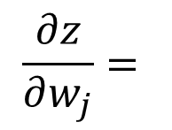
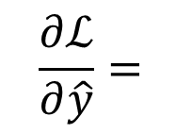
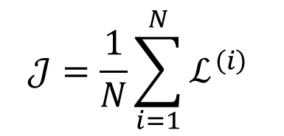
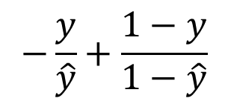
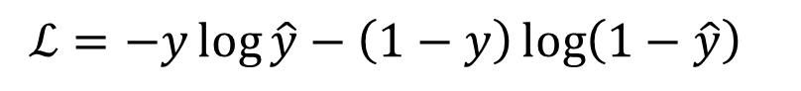
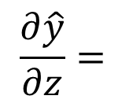
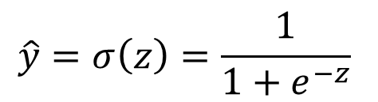
Gradient Descent
$$z=w^{T}x+b$$
$$\frac{∂z}{∂w_{j}}=$$
$$x_{j}$$
$$\hat{y}=σ\left(z\right)=\frac{1}{1+e^{−z}}$$
$$\frac{∂\hat{y}}{∂z}=$$
$$\hat{y}\left(1−\hat{y}\right)$$
$$ℒ=−y\log{\hat{y}}−\left(1−y\right)\log\left(1−\hat{y}\right)$$
$$\frac{∂ℒ}{∂\hat{y}}=$$
$$−\frac{y}{\hat{y}}+\frac{1−y}{1−\hat{y}}$$
$$𝒥=\frac{1}{N}\sum_{i=1}^{N}{ℒ^{\left(i\right)}}$$
$$\frac{∂𝒥}{∂ℒ^{\left(i\right)}}=$$
$$\frac{1}{N}$$

Slide 12
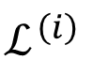

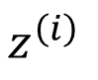





















Gradient Descent
$$z^{\left(1\right)}$$
$${\hat{y}}^{\left(1\right)}$$
$$ℒ^{\left(1\right)}$$
$$…$$
$$…$$
$$…$$
$$w_{j}$$
$$z^{\left(i\right)}$$
$${\hat{y}}^{\left(i\right)}$$
$$ℒ^{\left(i\right)}$$
$$𝒥$$
$$z=w^{T}x+b$$
$$…$$
$$…$$
$$…$$
$$\hat{y}=σ\left(z\right)=\frac{1}{1+e^{−z}}$$
$$z^{\left(N\right)}$$
$${\hat{y}}^{\left(N\right)}$$
$$ℒ^{\left(N\right)}$$
$$ℒ=−y\log{\hat{y}}−\left(1−y\right)\log\left(1−\hat{y}\right)$$
$$𝒥=\frac{1}{N}\sum_{i=1}^{N}{ℒ^{\left(i\right)}}$$
$$\frac{∂𝒥}{∂w_{j}}=\sum_{i=1}^{N}{\frac{∂𝒥}{∂ℒ^{\left(i\right)}}}\frac{∂ℒ^{\left(i\right)}}{∂{\hat{y}}^{\left(i\right)}}\frac{∂{\hat{y}}^{\left(i\right)}}{∂z^{\left(i\right)}}\frac{∂z^{\left(i\right)}}{∂w_{j}}$$
$$=\frac{1}{N}\sum_{i=1}^{N}{\left(−\frac{y^{\left(i\right)}}{{\hat{y}}^{\left(i\right)}}+\frac{1−y^{\left(i\right)}}{1−{\hat{y}}^{\left(i\right)}}\right){\hat{y}}^{\left(i\right)}\left(1−{\hat{y}}^{\left(i\right)}\right)x_{j}^{\left(i\right)}}=\frac{1}{N}\sum_{i=1}^{N}{\left({\hat{y}}^{\left(i\right)}−y^{\left(i\right)}\right)x_{j}^{\left(i\right)}}$$
Calculate $\frac{∂𝒥}{∂b}$

Slide 13







Summary
Model and Loss/Cost functions
$$𝒥=\frac{1}{N}\sum_{i=1}^{N}{ℒ^{\left(i\right)}}$$
$$\hat{y}=σ\left(z\right)=\frac{1}{1+e^{−z}}$$
$$z=w^{T}x+b$$
$$ℒ=−y\log{\hat{y}}−\left(1−y\right)\log\left(1−\hat{y}\right)$$
Calculate Gradient
$$∇𝒥\left(w,b\right)=\left[\begin{matrix}\frac{∂𝒥}{∂w} \\ \frac{∂𝒥}{∂b}\end{matrix}\right]=\left[\begin{matrix}\frac{1}{N}\sum_{i=1}^{N}{\left({\hat{y}}^{\left(i\right)}−y^{\left(i\right)}\right)x_{j}^{\left(i\right)}} \\ \frac{1}{N}\sum_{i=1}^{N}{\left({\hat{y}}^{\left(i\right)}−y^{\left(i\right)}\right)}\end{matrix}\right]$$
Update
$$w_{j}=w_{j}−α\frac{∂𝒥}{∂w_{j}}=w_{j}−\frac{α}{N}\sum_{i=1}^{N}{\left({\hat{y}}^{\left(i\right)}−y^{\left(i\right)}\right)x_{j}^{\left(i\right)}}$$
$$b=b−α\frac{∂𝒥}{∂b}=b−\frac{α}{N}\sum_{i=1}^{N}{\left({\hat{y}}^{\left(i\right)}−y^{\left(i\right)}\right)}$$

Slide 14
Thank you！

